Slide 1

18 NOVEMBER 2025
The Death of the __gap
Custom Storage Layouts

Slide 2


WHOAMI
Eric Marti Haynes
Tokenization Tech Lead @Nethermind

Slide 3

Upgradeable
Smart
Contracts
The Problem
The Solution
The Benefit
Standard smart contracts are immutable. You can't patch vulnerabilities or add new features.
Upgradeable pattern: use a Proxy contract that points to a separate Logic contract, that can be replaced.
The contract's address and all its data stay the same. You can change the contract's logic without changing its address.

Slide 4
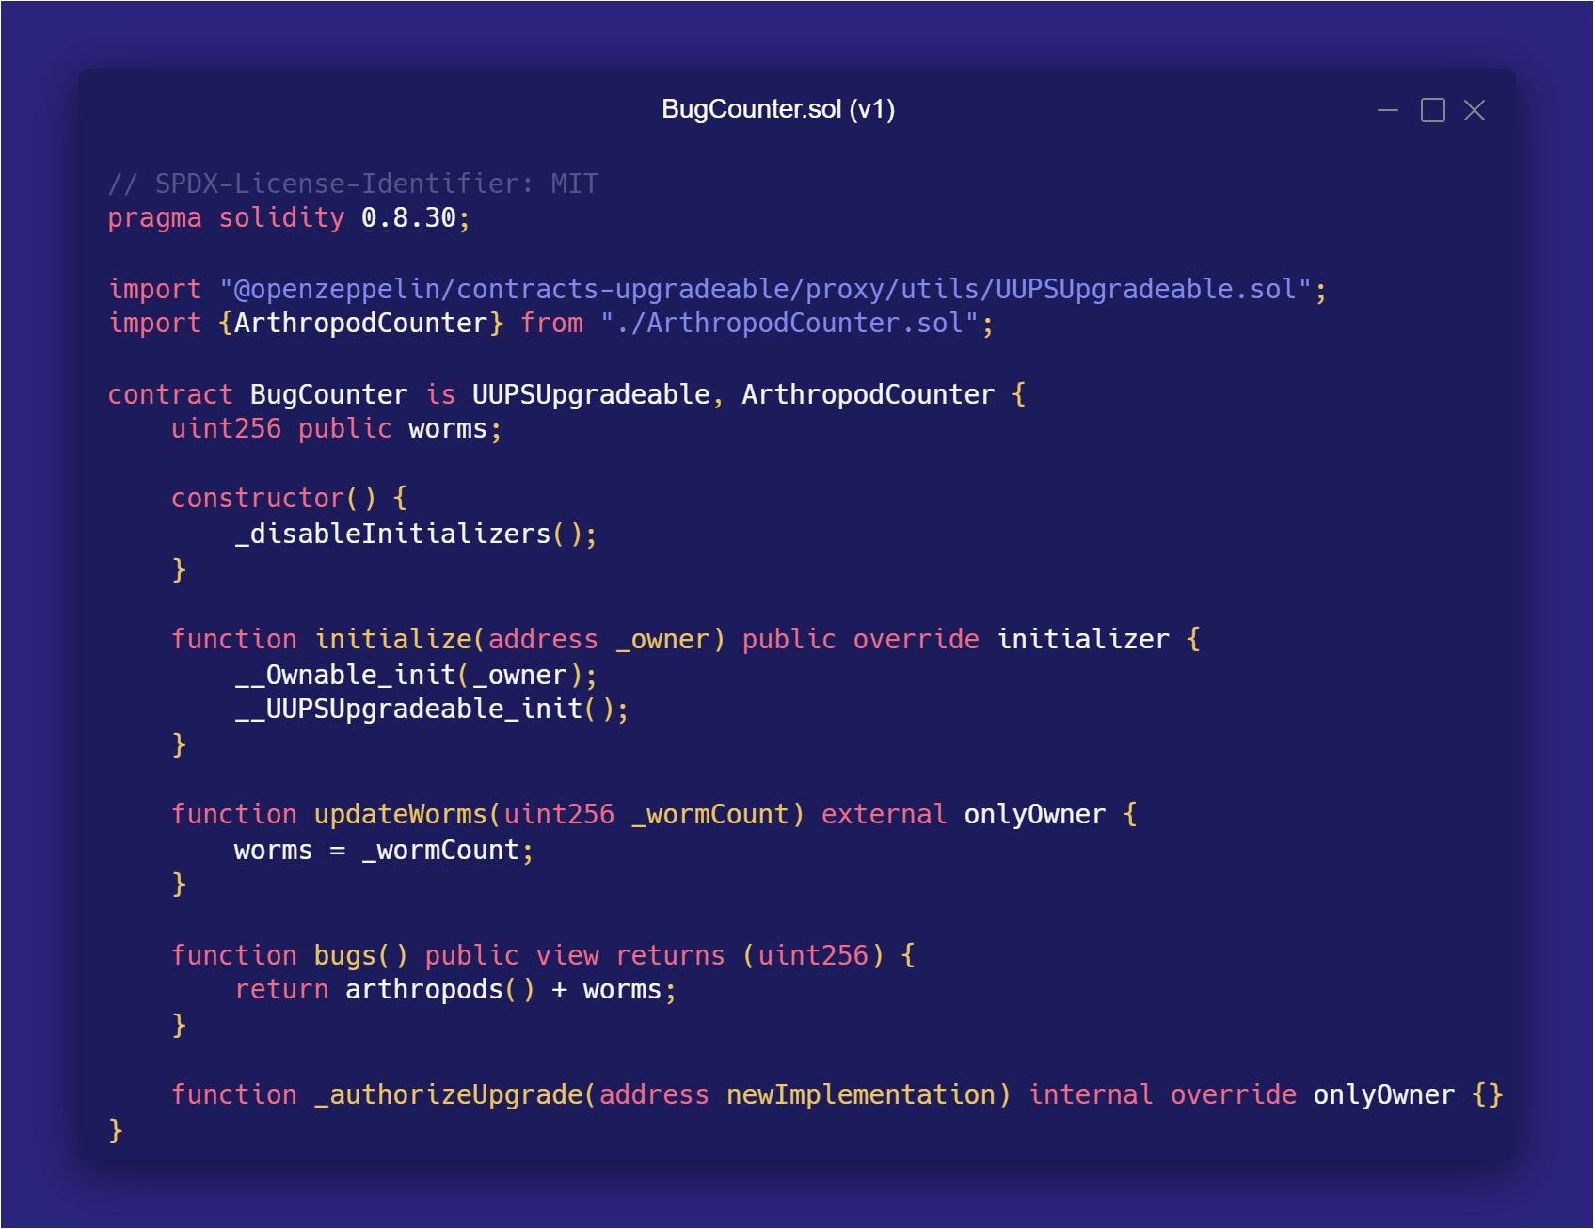


Slide 5
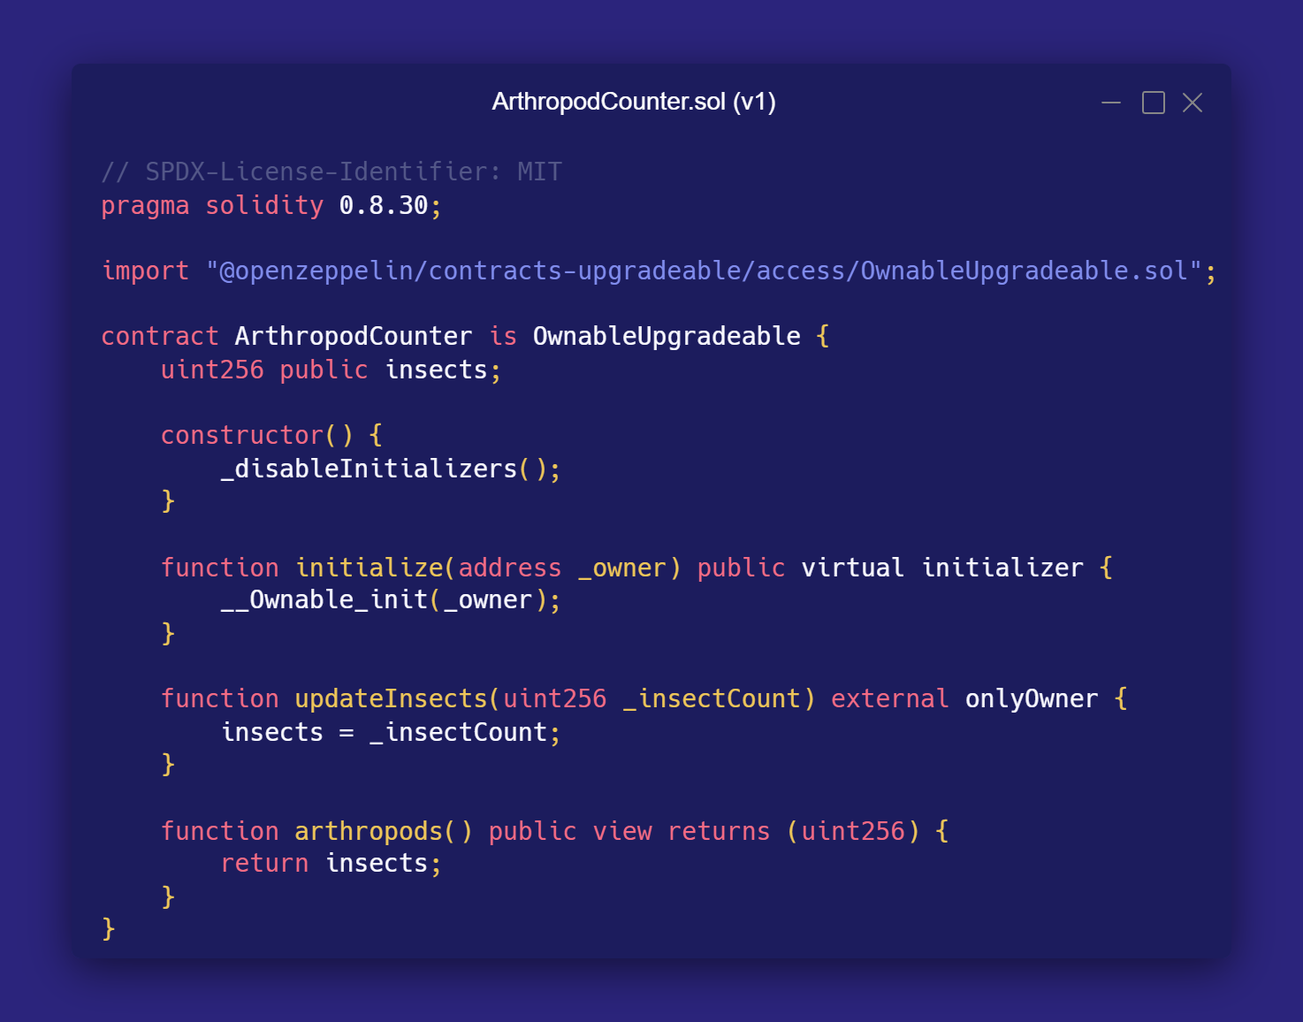

Slide 6
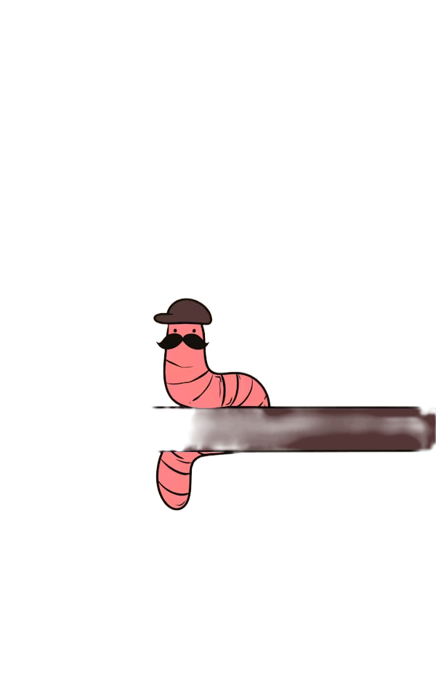

Variable | Slot | Value
uint256 insects | 0 | 0x07
uint256 worms | 1 | 0x03

Slide 7
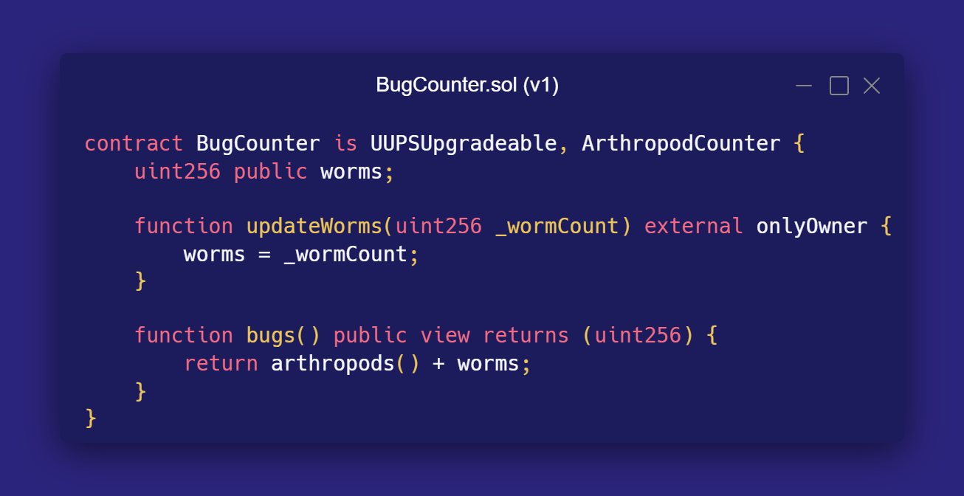
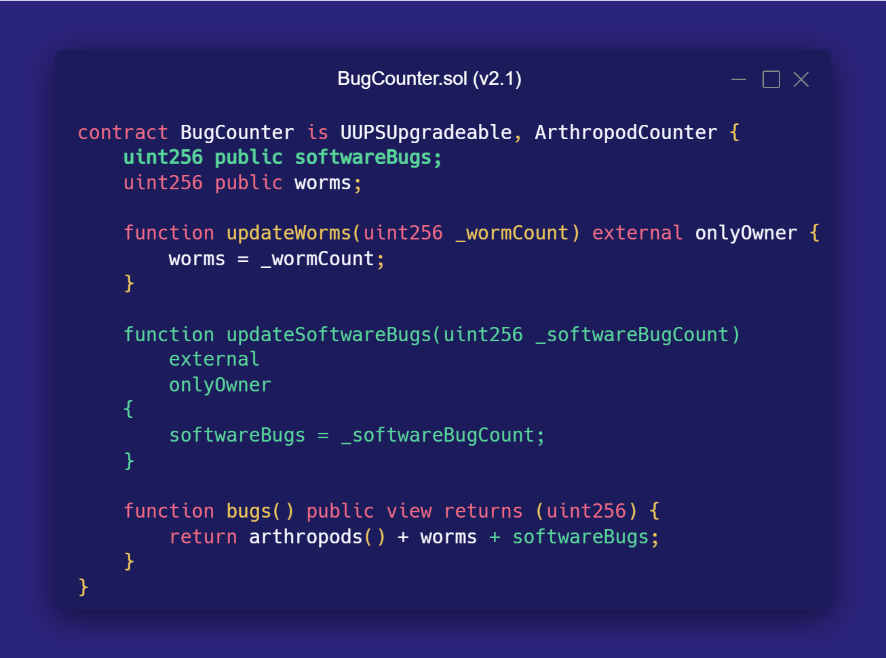
BEFORE
AFTER

Slide 8

Variable | Slot | Value
uint256 insects | 0 | 0x07
uint256 worms softwareBugs | 1 | 0x03
uint256 worms | 2 | 0x00

Slide 9
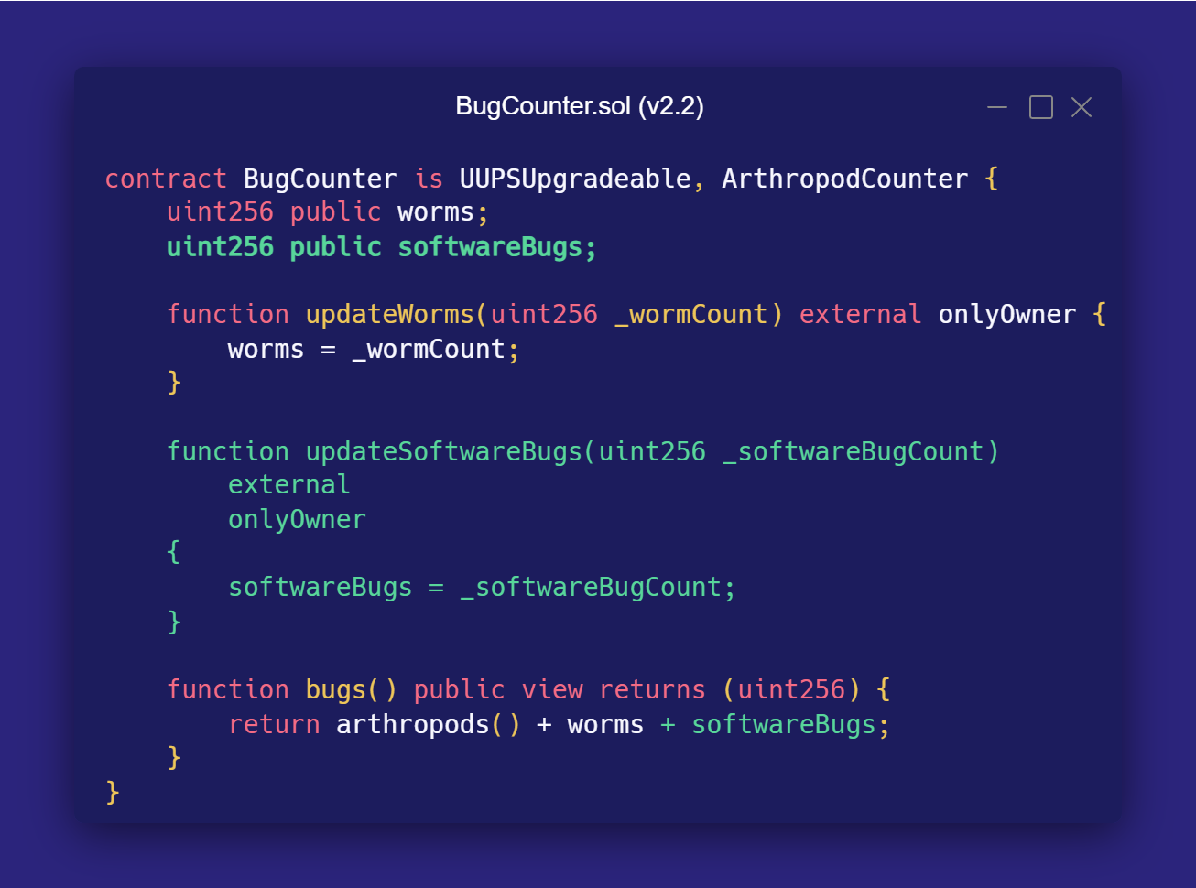
BEFORE
AFTER

Slide 10
Variable | Slot | Value
uint256 insects | 0 | 0x07
uint256 worms | 1 | 0x03
uint256 softwareBugs | 2 | 0x02

Slide 11
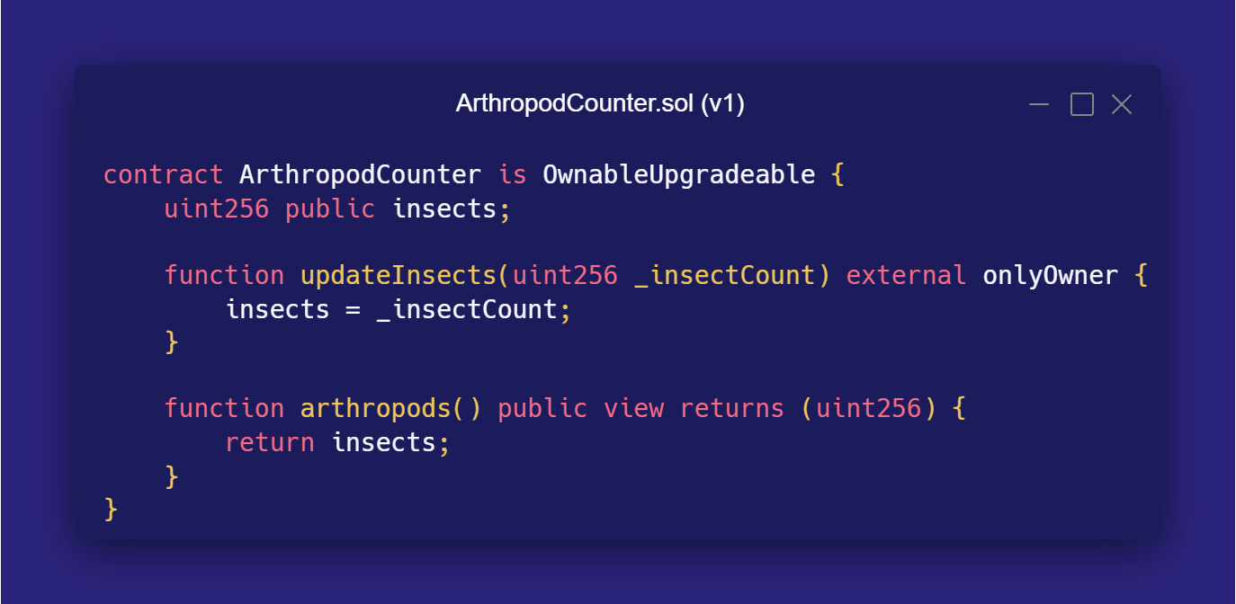
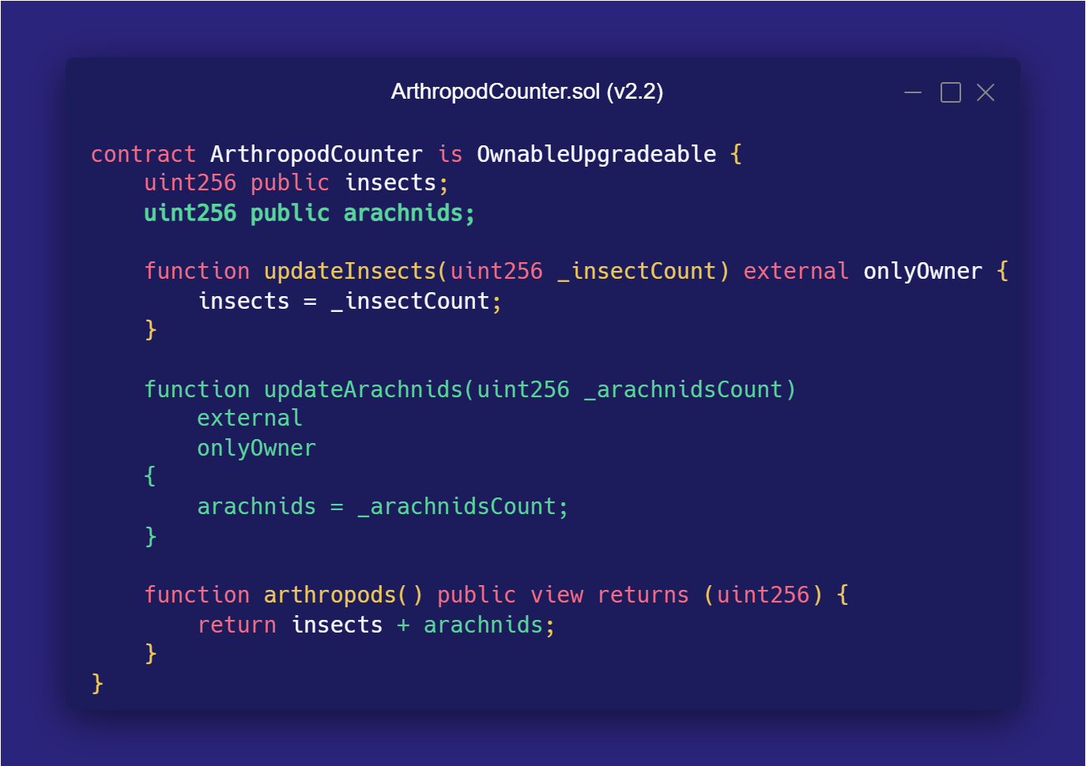
BEFORE
AFTER

Slide 12

Variable | Slot | Value
uint256 insects | 0 | 0x07
uint256 worms arachnids | 1 | 0x03
uint256 softwareBugs worms | 2 | 0x02
uint256 softwareBugs | 3 | 0x00

Slide 13

Botched Smart Contract Upgrades
Additional time & resources
Corrupt storage & DoS
Exploits & loss of funds

Slide 14

“
Audius, web3’s answer to Spotify, has fallen victim to a governance attack, losing $6M of its native token, AUDIO.
— REKT, 2022

Slide 15
Storage Gaps
History
Purpose
Mechanism
Introduced and popularized by the OpenZeppelin team around 2019.
Preventing storage slot collisions in upgradeable proxy contracts.
Reserving empty storage slots for future variables, through large empty arrays at the end of contracts.

Slide 16
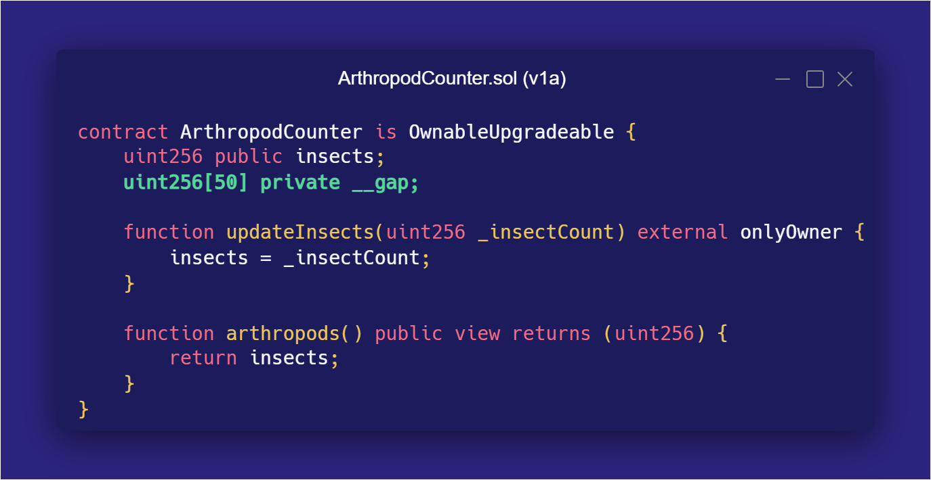
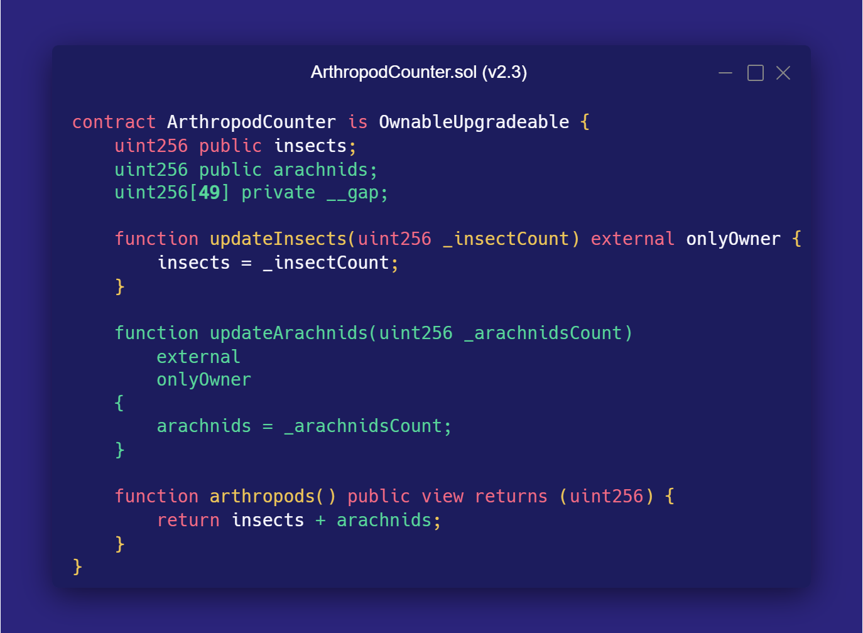
BEFORE
AFTER

Slide 17
Variable | Slot | Value
uint256 insects | 0 | 0x07
uint256 __gap[0] arachnids | 1 | 0x01
uint256 __gap[0] | 2 | 0x00
… | … | 0x00
uint256 __gap[48] | 50 | 0x00
uint256 worms | 51 | 0x03
uint256 softwareBugs | 52 | 0x02

Slide 18

Storage Gap Issues
Fixed Size
Manual Updates
Inheritance Tree

Slide 19
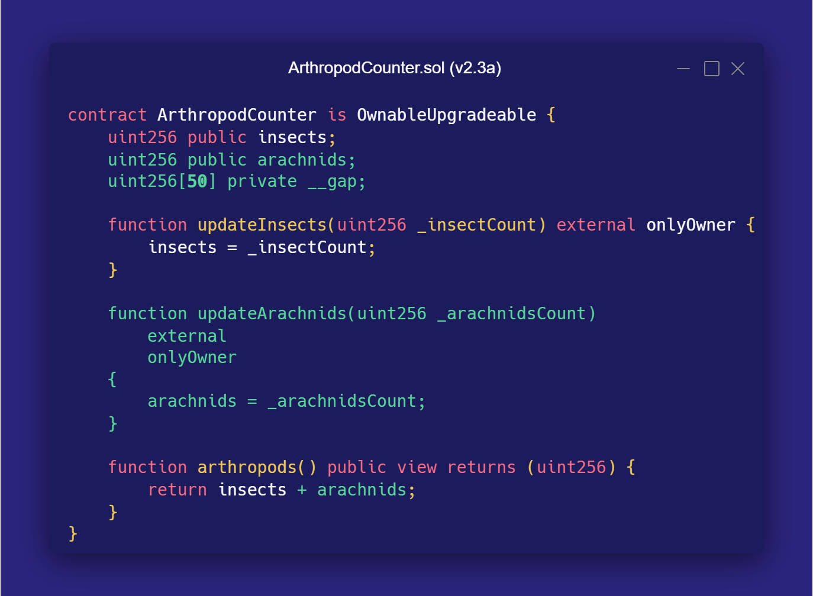
BEFORE
AFTER

Slide 20
Variable | Slot | Value
uint256 insects | 0 | 0x07
uint256 __gap[0] arachnids | 1 | 0x01
uint256 __gap[0] | 2 | 0x00
… | … | 0x00
uint256 __gap[48] | 50 | 0x00
uint256 worms __gap[49] | 51 | 0x03
uint256 softwareBugs worms | 52 | 0x02
uint256 softwareBugs | 53 | 0x00

Slide 21
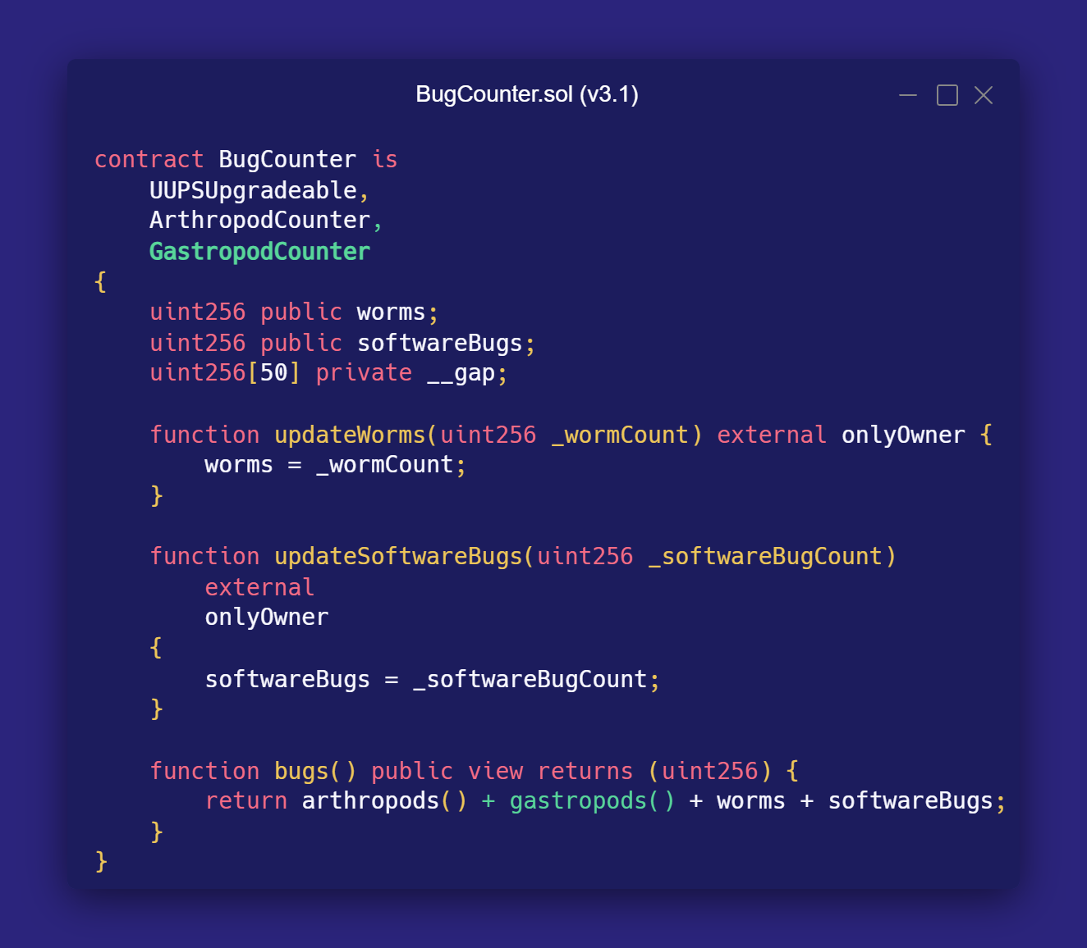
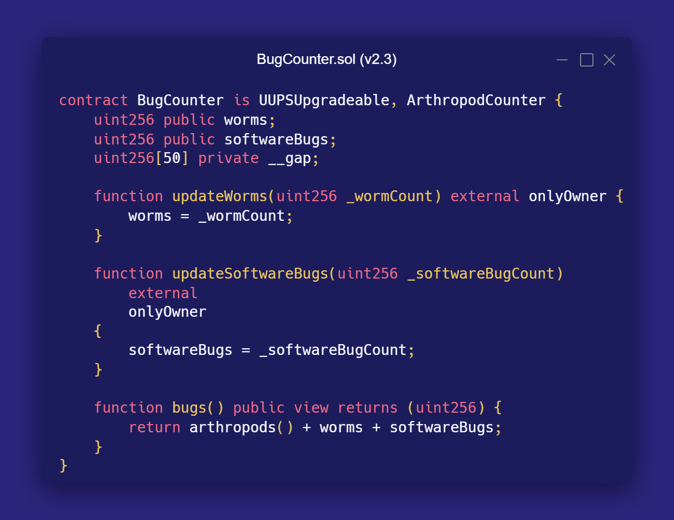
BEFORE
AFTER

Slide 22
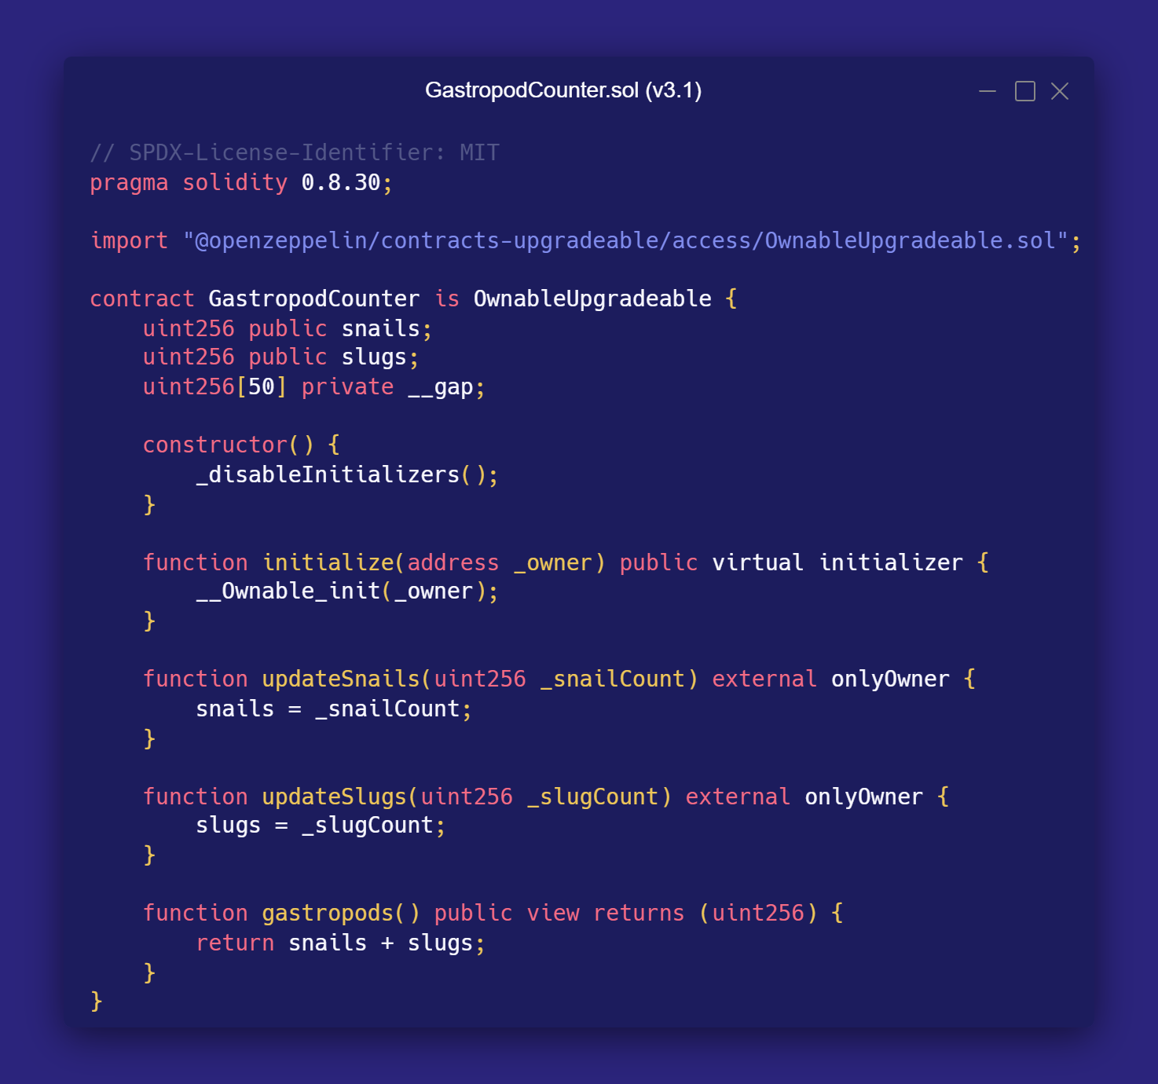

Slide 23

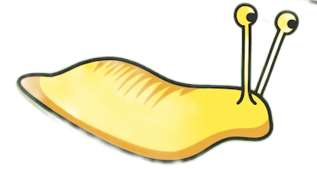
Variable | Slot | Value
uint256 insects | 0 | 0x07
uint256 arachnids | 1 | 0x01
uint256[49] __gap | 2->50 | 0x00
uint256 worms snails | 51 | 0x03
uint256 softwareBugs slugs | 52 | 0x02
uint256[50] __gap | 53->102 | 0x00
uint256 worms | 103 | 0x00
uint256 softwareBugs | 104 | 0x00

Slide 24
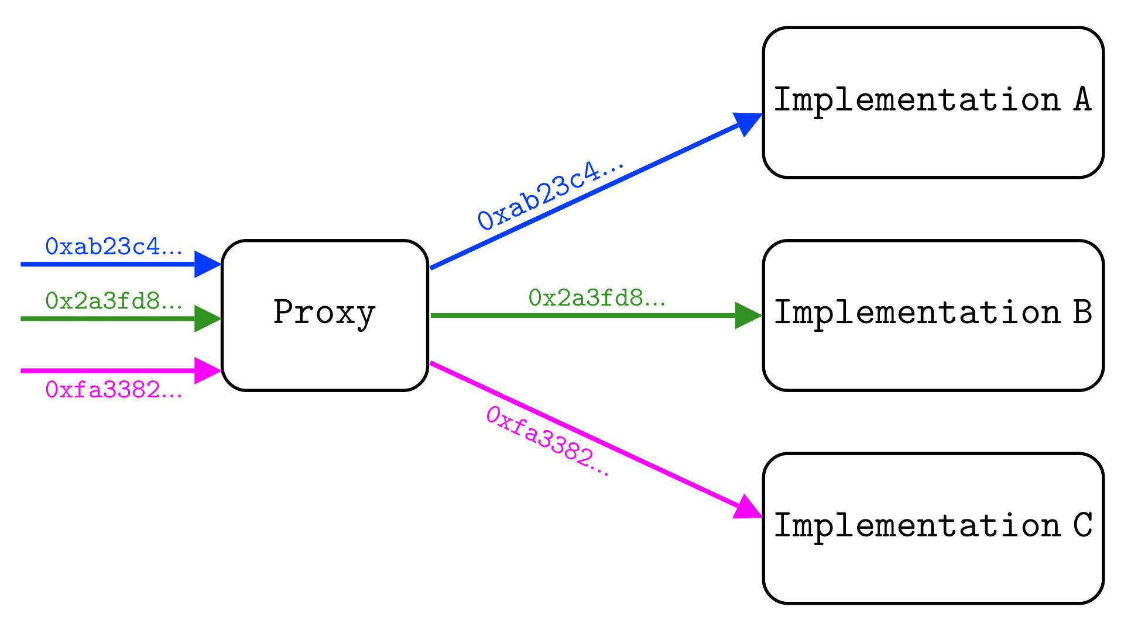

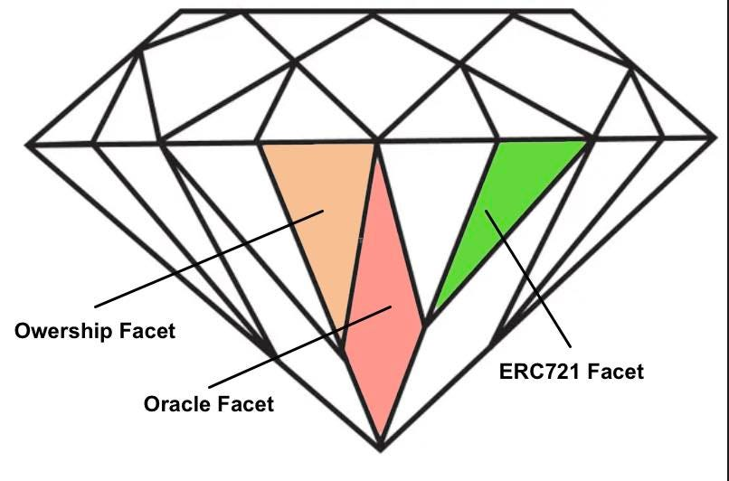
ERC-2535: Diamonds, Multi-Facet Proxy Create modular smart contract systems that can be extended after deployment
Nick Mudge
This proposal standardizes diamonds, which are modular smart contract systems that can be upgraded/extended after deployment, and have virtually no size limit. More technically, a diamond is a contract with external functions that are supplied by contracts called facets. Facets are separate, independent contracts that can share internal functions, libraries, and state variables.
“

Slide 25
Diamond Storage Formula
SLOT = keccak256("myproject.erc20")

Slide 26
Diamond Storage
Storage identifiers based on simple string literals
Use not limited to Diamond Multi-Facet Proxies
Currently being standardized with ERC-8042
Can be used as an alternative to storage gaps

Slide 27
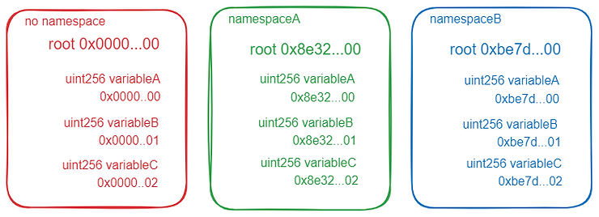
ERC-7201: Namespaced Storage Layout Conventions for the storage location of structs in the namespaced storage pattern.
We define the NatSpec annotation @custom:storage-location to document storage namespaces and their location in storage in Solidity or Vyper source code. Additionally, we define a formula to derive a location from an arbitrary identifier. The formula is chosen to be safe against collisions with the storage layouts used by Solidity and Vyper.
“

Slide 28
Namespaced Storage Formula
SLOT = keccak256(keccak256(“myproject.erc20”) - 1) & ~0xff

Slide 29
Namespaced Storage
Multiple hashing guarantee that namespace slots are completely disjoint from standard storage
Namespace locations are aligned to 256 as a potential future gas optimization
Standardized with ERC-7201
Can be used as an alternative to storage gaps

Slide 30
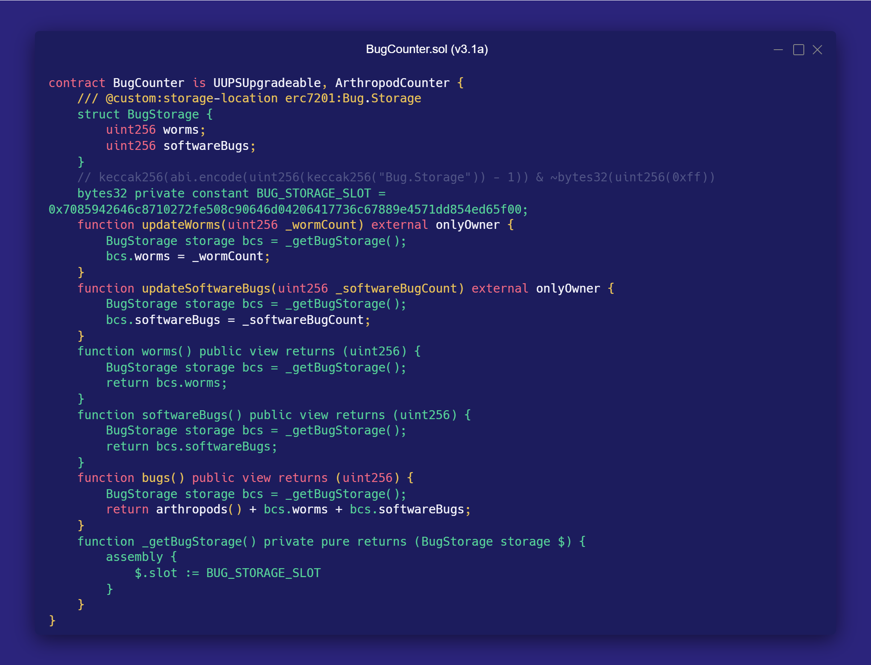
BEFORE

Slide 31
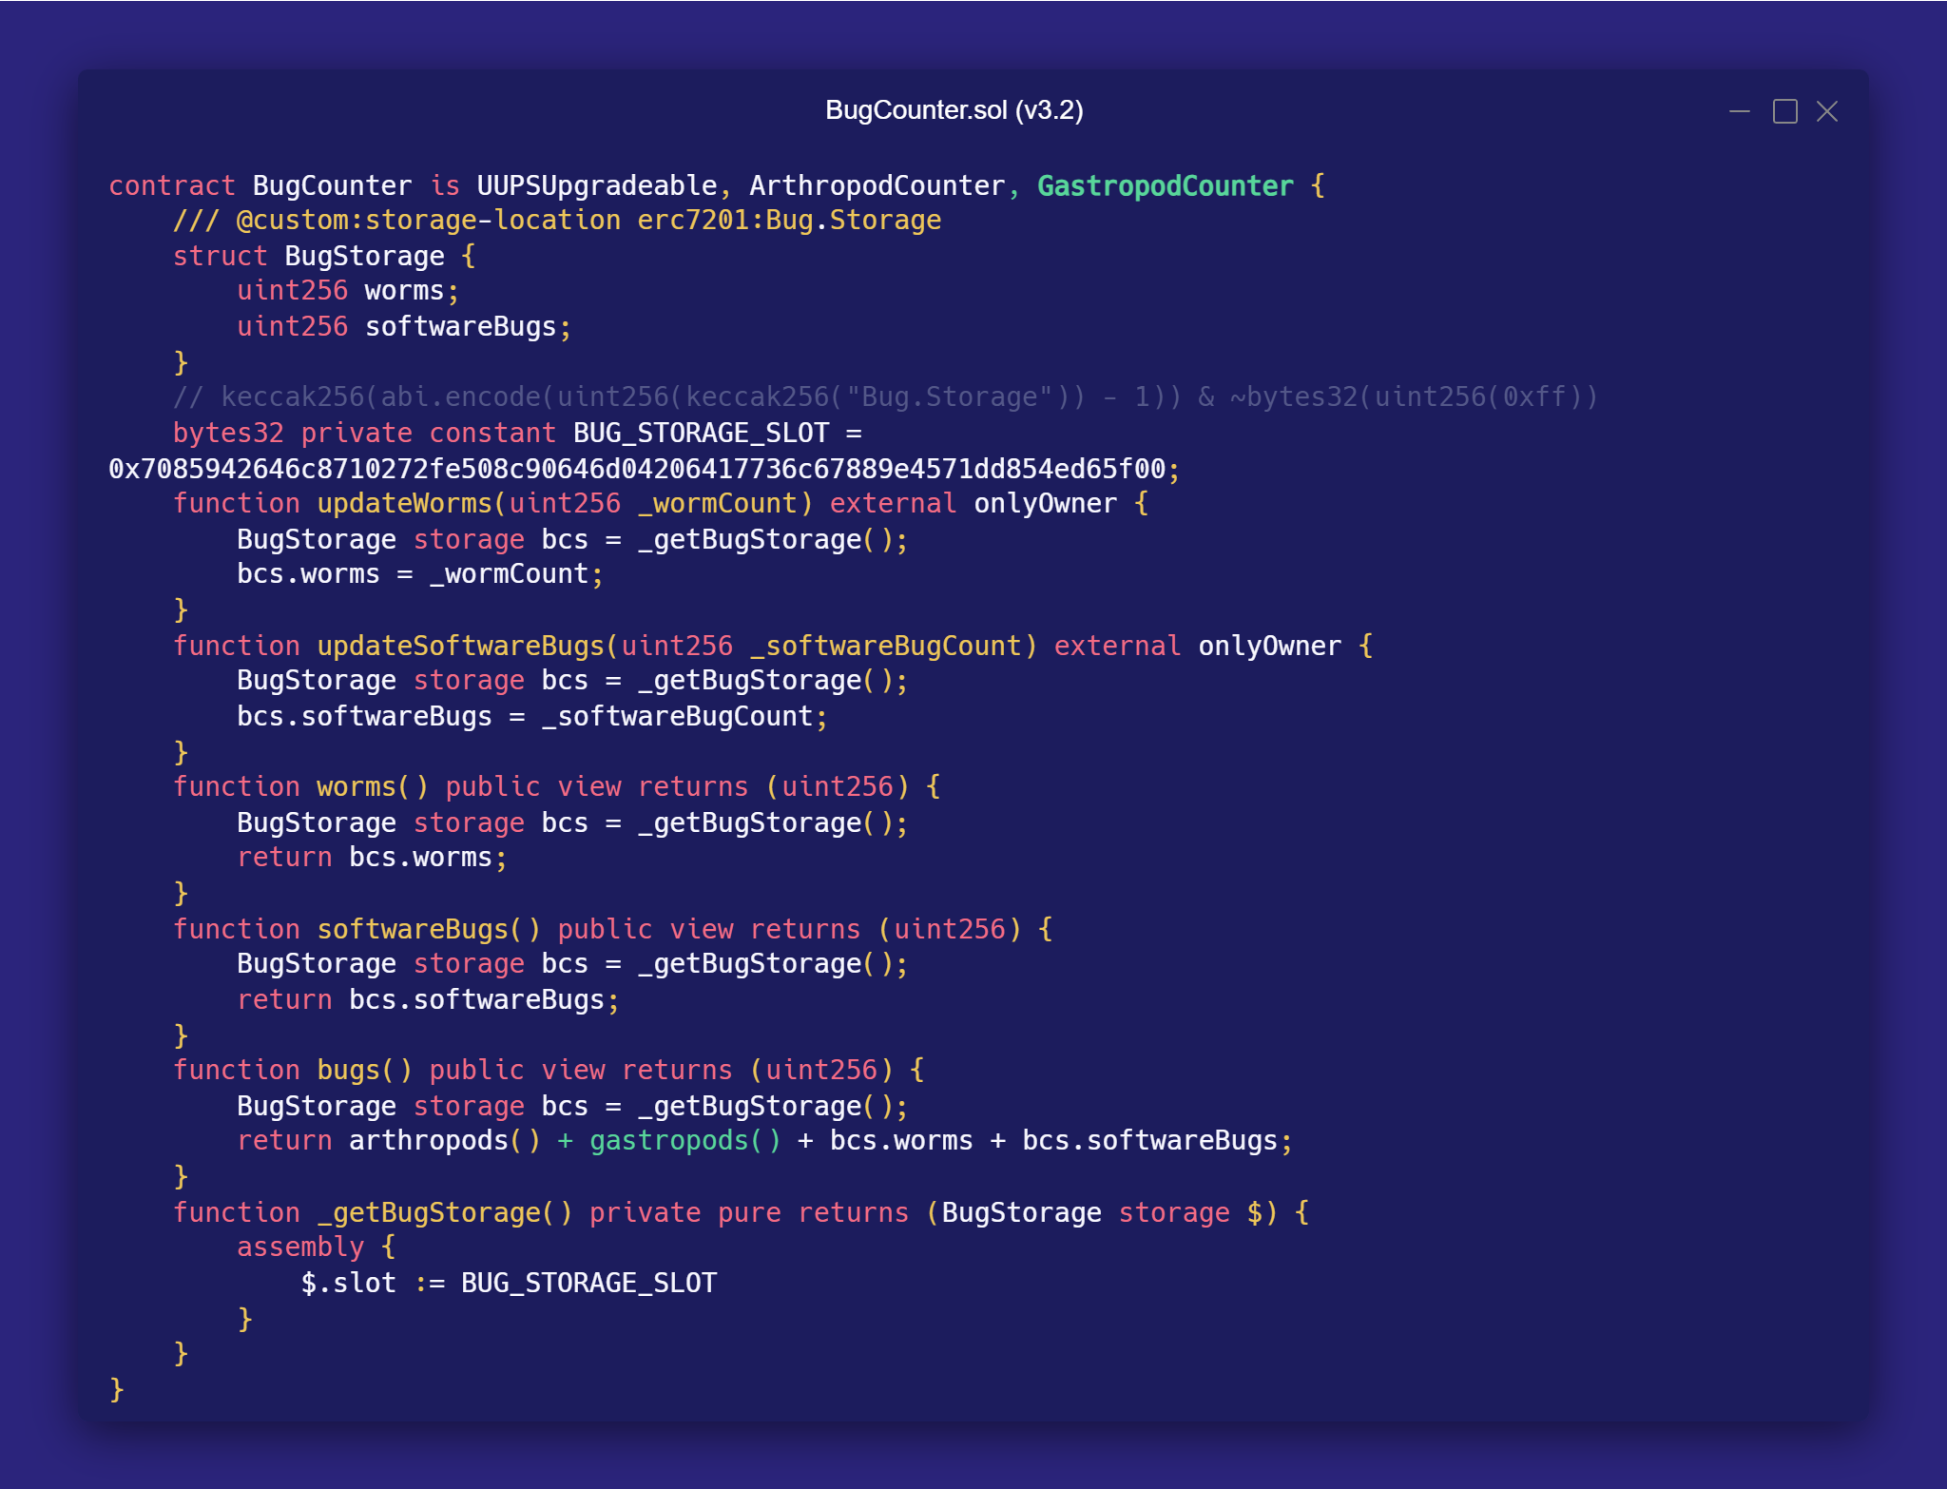
AFTER

Slide 32
Variable | Slot | Value
uint256 insects | 0x9e...00 | 0x07
uint256 arachnids | 0x9e...01 | 0x01
uint256 snails | 0xc9...00 | 0x09
uint256 slugs | 0xc9...01 | 0x05
uint256 worms | 0x70...00 | 0x03
uint256 softwareBugs | 0x70...01 | 0x02

Slide 33
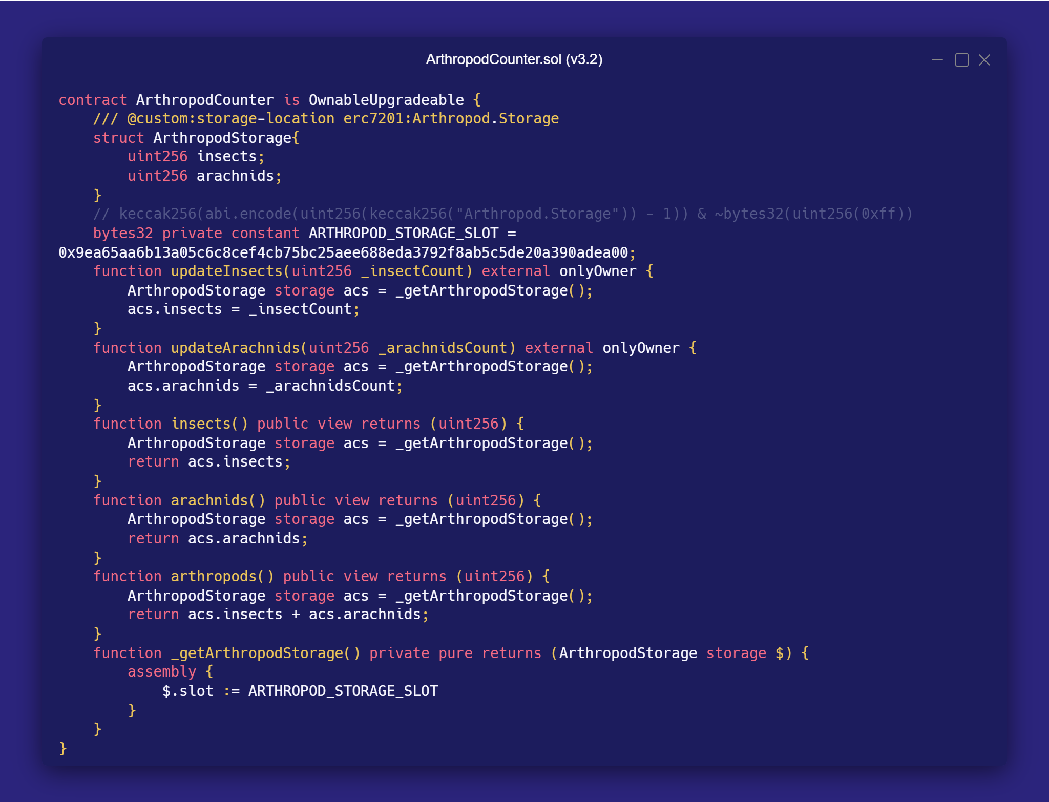

Slide 34
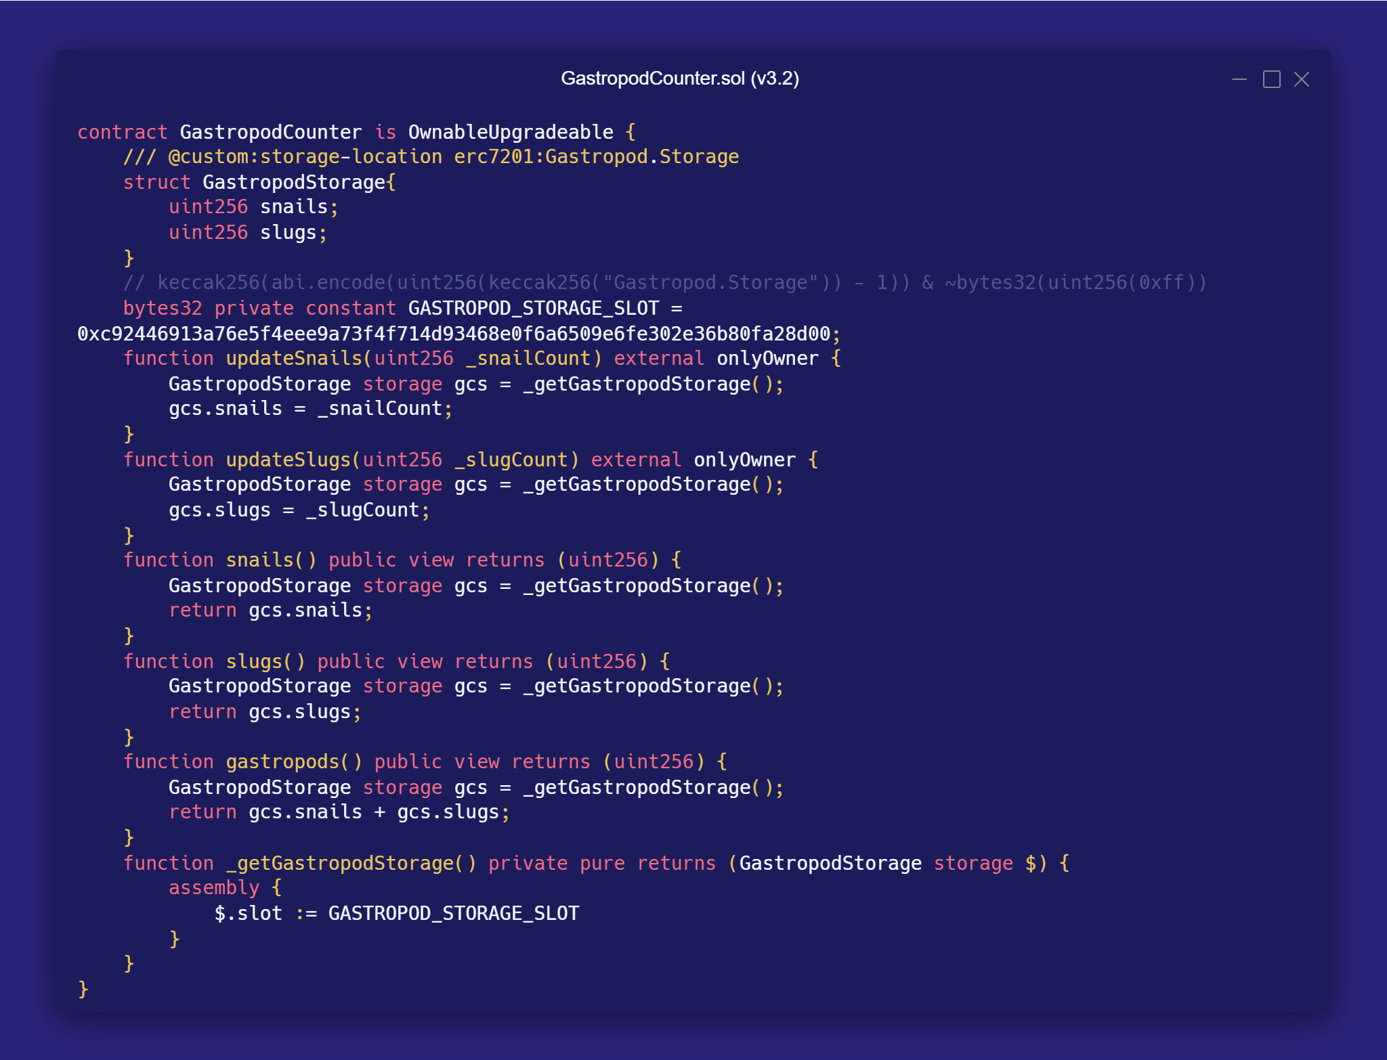

Slide 35
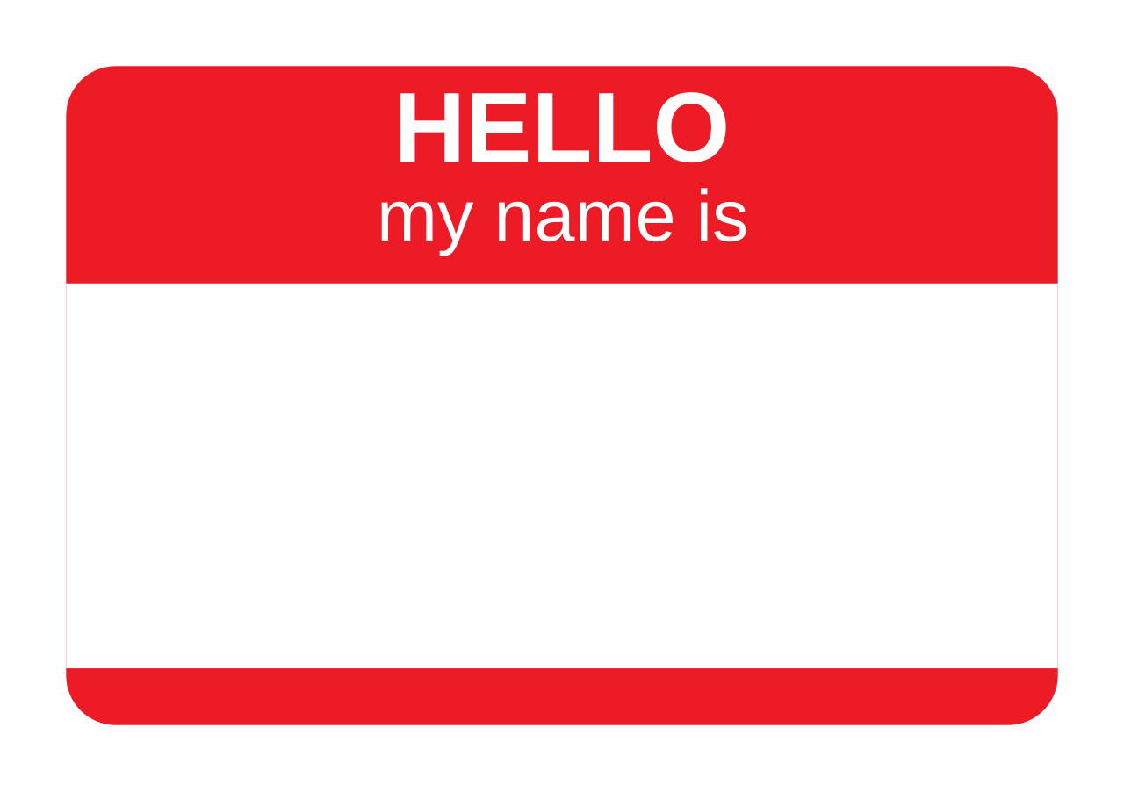
Namespaced Storage Issues
Manul Hardcoded Hash
0x0ac1b4664d8039d3514536dbcd255edfc9eda1954331d0b66219f077a1b0b7a4
Usage of Assembly
Verbose & Complex Syntax

Slide 36

0.8.29
This Solidity release introduces syntax for relocating contract's storage variables to an arbitrary location.
EIP-7702
Support for Custom Storage Layouts in Solidity
With the inclusion of EIP-7702: Set EOA account code in the Pectra upgrade, it has now become critical for safe implementation of account abstraction.

Slide 37
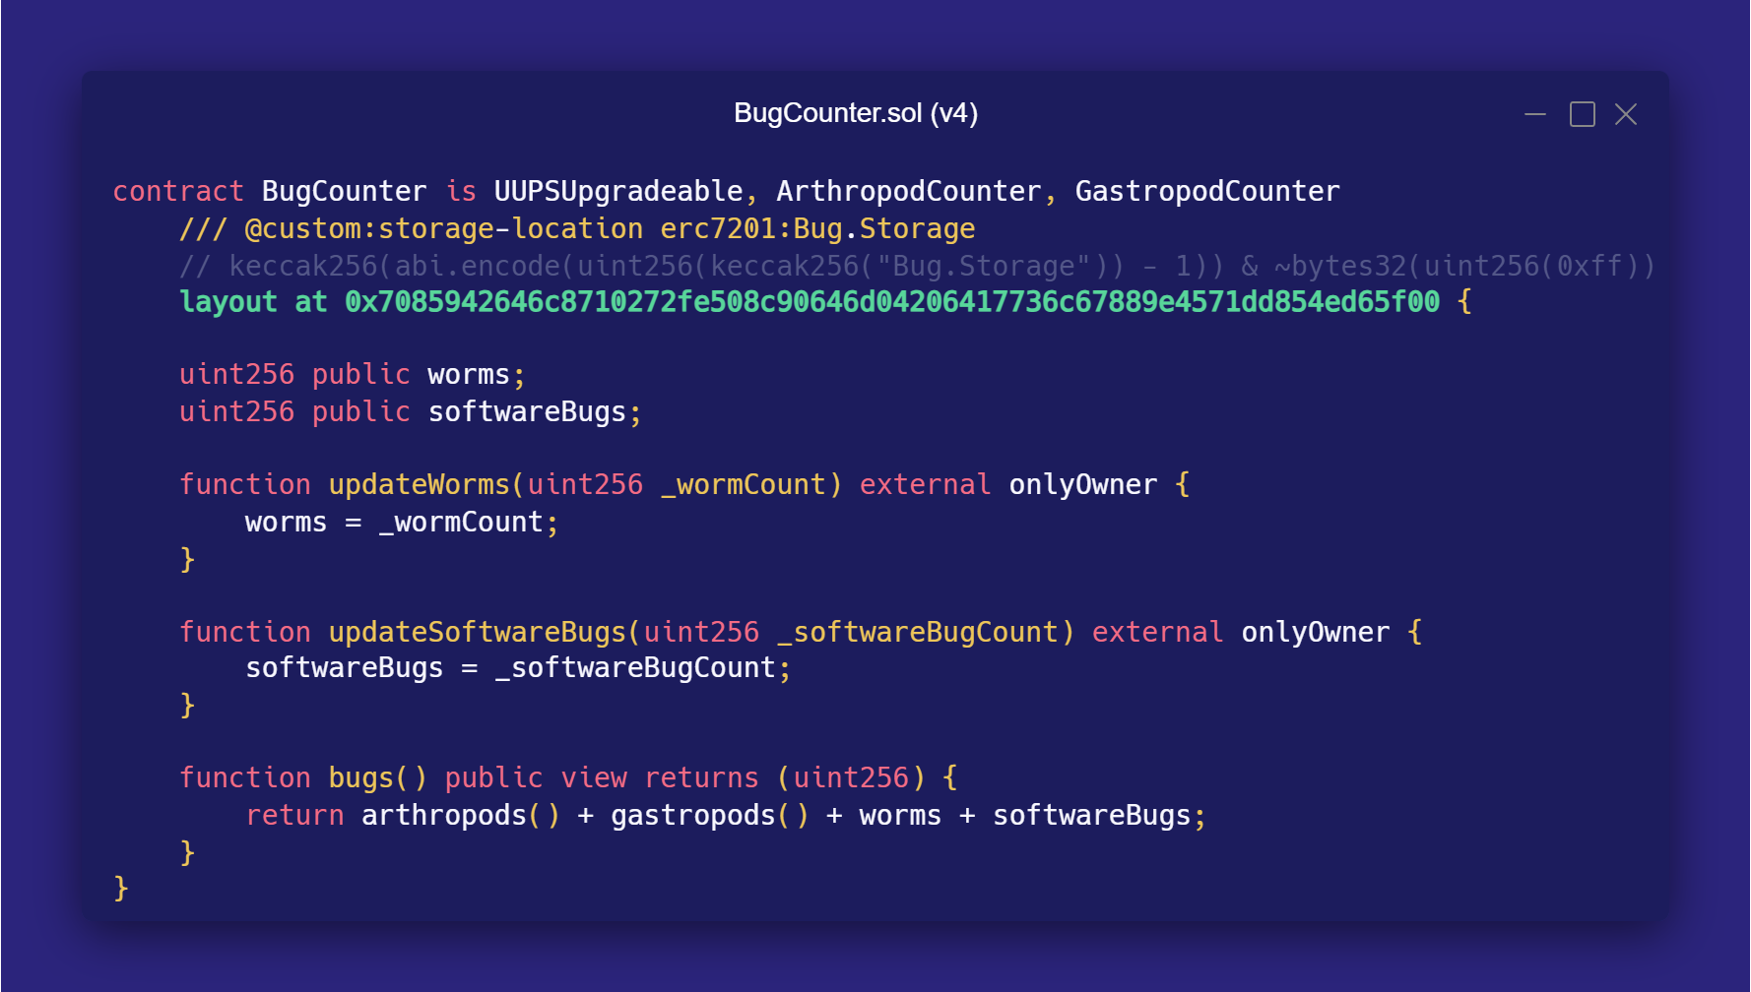

Slide 38
Variable | Slot | Value
uint256 insects | 0x9e...00 | 0x07
uint256 arachnids | 0x9e...01 | 0x01
uint256 snails | 0xc9...00 | 0x09
uint256 slugs | 0xc9...01 | 0x05
uint256 worms | 0x70...00 | 0x03
uint256 softwareBugs | 0x70...01 | 0x02

Slide 39
“
Currently the syntax is very limited: the base location can only be a literal expression and applies to the whole inheritance tree.
—SOLIDITY TEAM

Slide 40


Slide 41
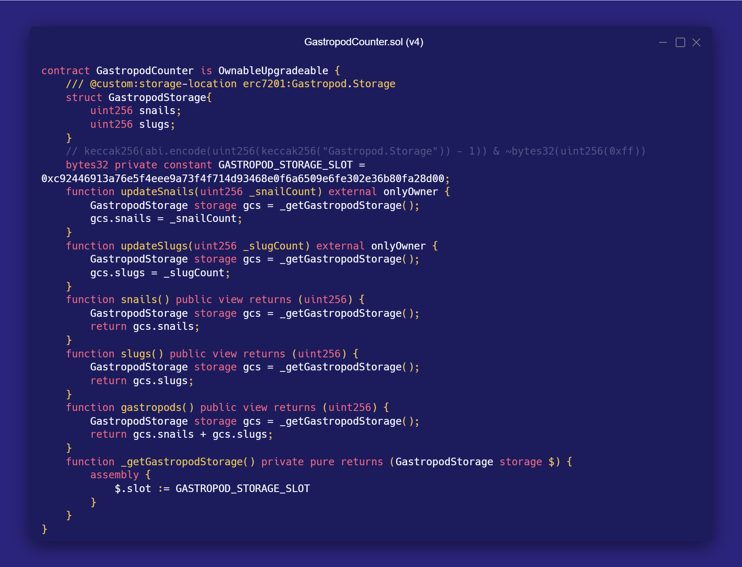

Slide 42
“
As the next step we are planning to allow using constants and add special-purpose helpers for the most commonly used layouts (in particular ERC-7201: Namespaced Storage Layout)
—SOLIDITY TEAM

Slide 43
What full support for Custom Storage Layouts could look like:

Slide 44
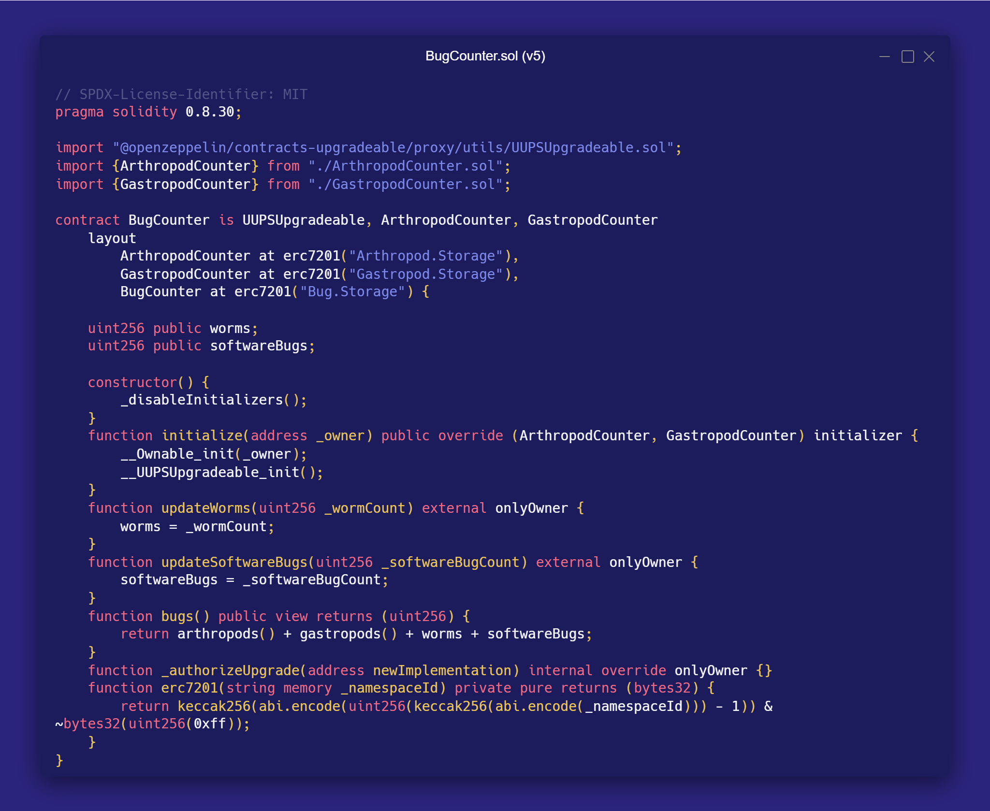

Slide 45
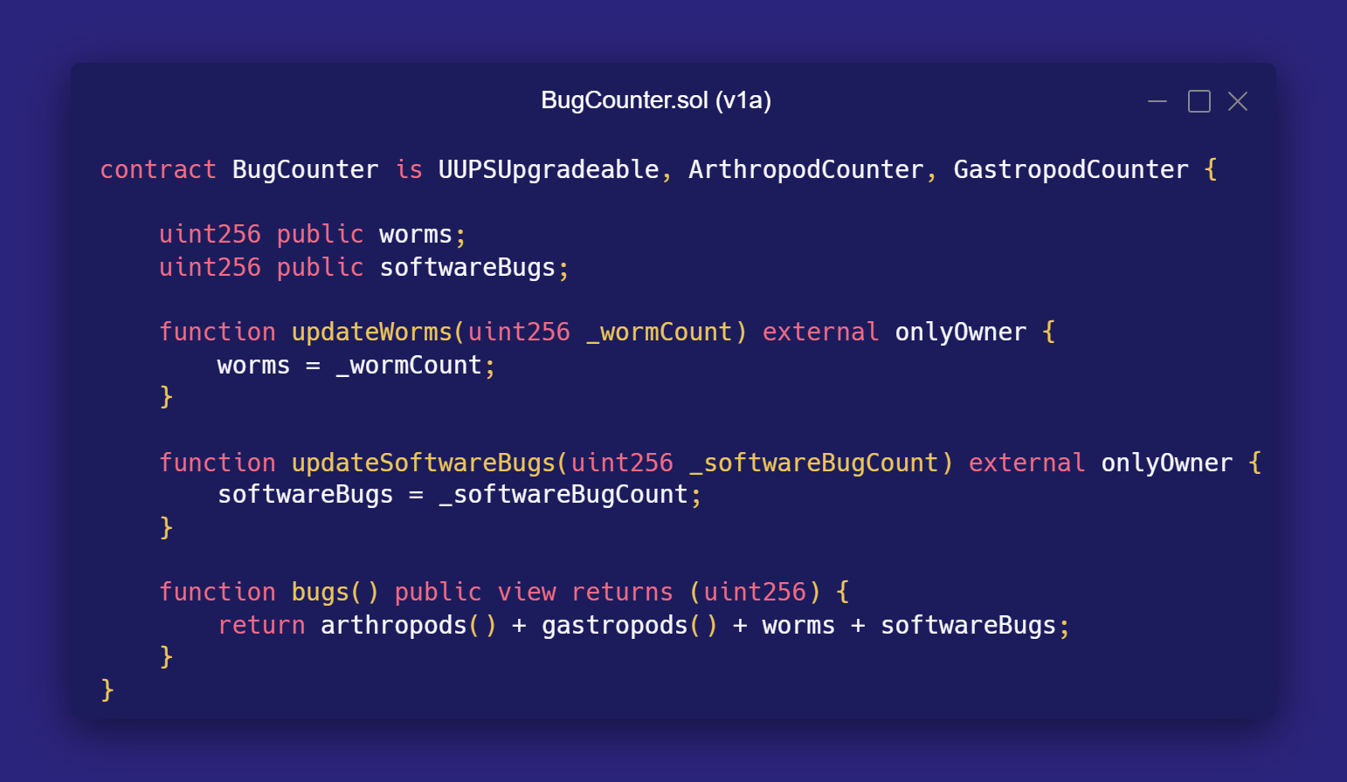
BEFORE

Slide 46
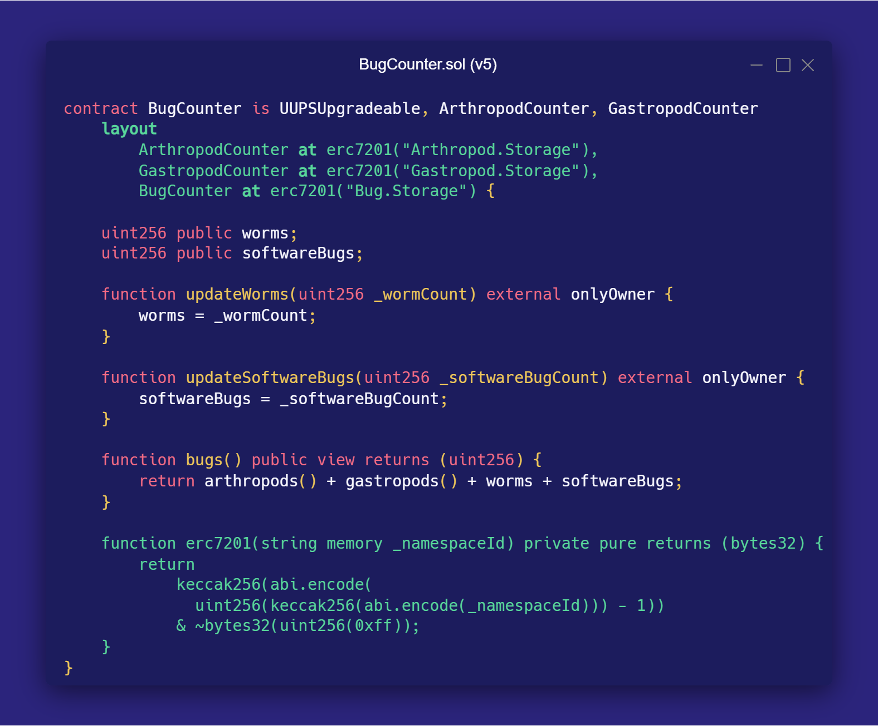
AFTER

Slide 47
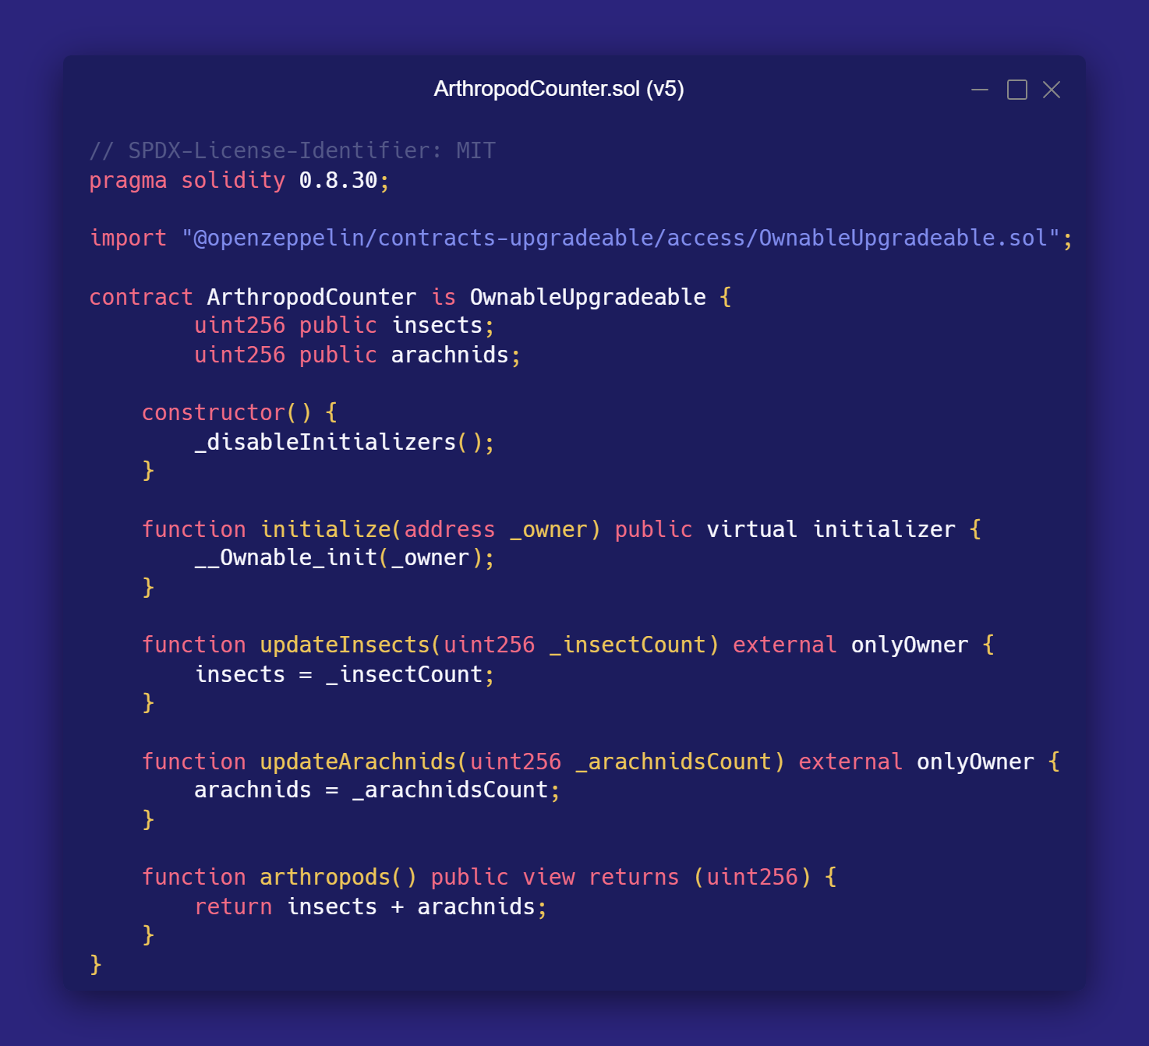

Slide 48
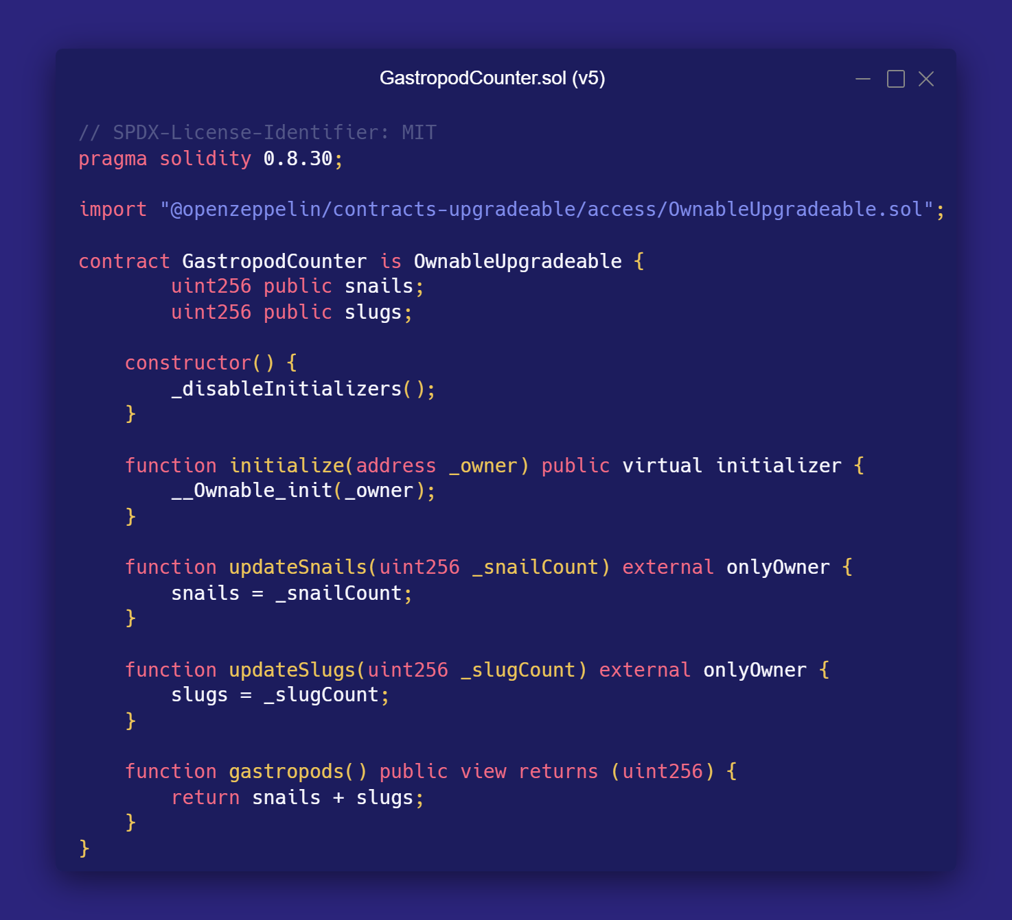

Slide 49
Variable | Slot | Value
uint256 insects | 0x9e...00 | 0x07
uint256 arachnids | 0x9e...01 | 0x01
uint256 snails | 0xc9...00 | 0x09
uint256 slugs | 0xc9...01 | 0x05
uint256 worms | 0x70...00 | 0x03
uint256 softwareBugs | 0x70...01 | 0x02

Slide 50
UPGRADEABILITY TIMELINE
The Storage Gap is dying. Let’s make sure native Solidity Custom Storage Layouts are the final nail in the coffin. In conjunction with patterns such as Namespaced Storage, let’s work together to make the future of smart contract upgrades easy, simple, and safe.
PAST
FUTURE
Nothing
Storage Gaps
ERC-7201
Custom Storage Layouts

Slide 51



GRACIAS
& Upgrade
Let’s build together!
www.nethermind.io
ericmartihaynes
ericmartihaynes

